Slide 1
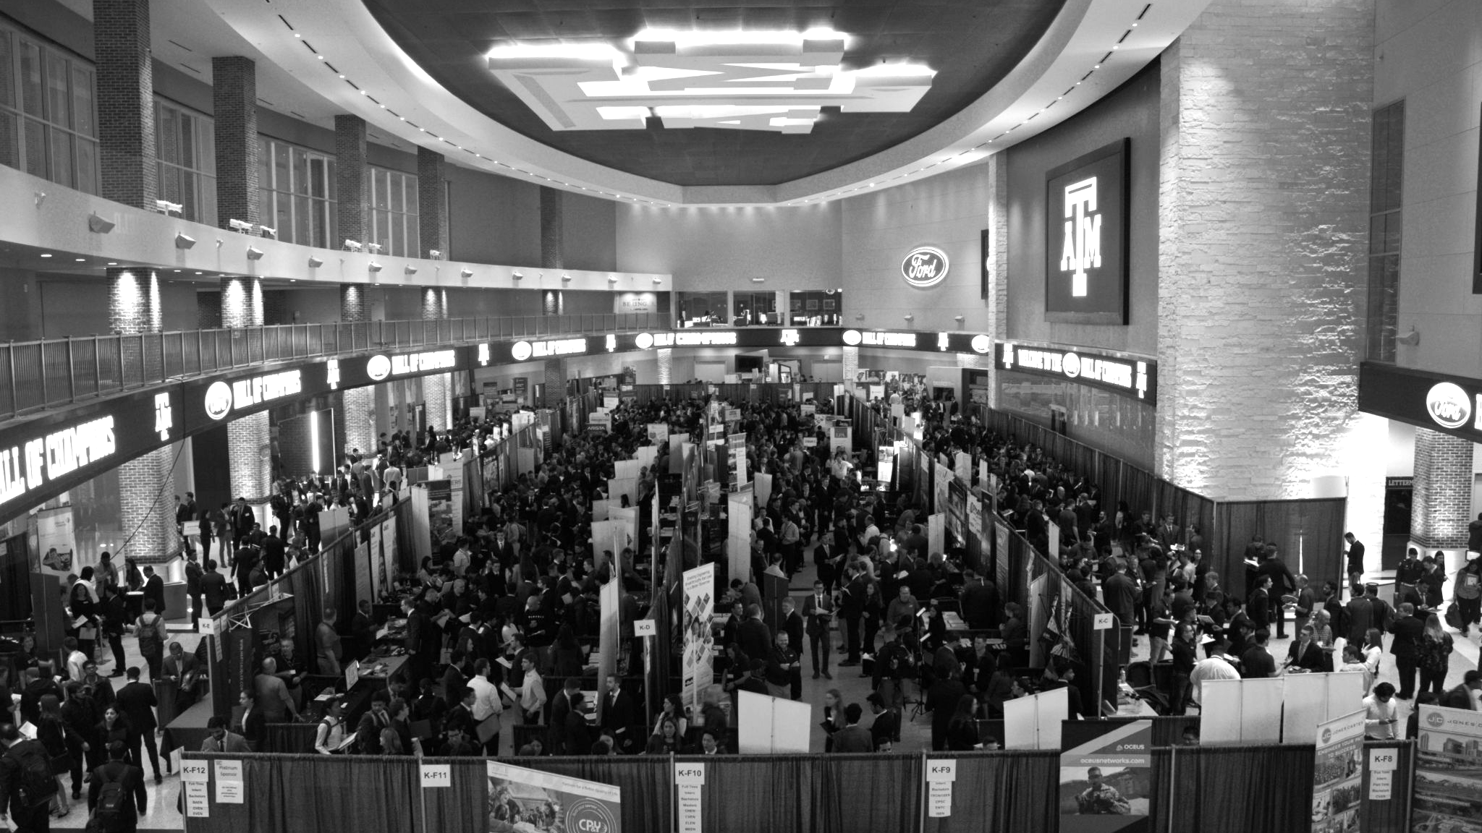

LANL Team Project Update
4/9/2025
Izzy Baumler, Dalton Boeckmann, Morgan Gullo, Jade Waldron

Slide 2
Problem Statement/Project Motivation
There is a need for a technology that has 5 DOF and can move through its full range of motion in each degree of freedom of at least 1 Hz.

Slide 3
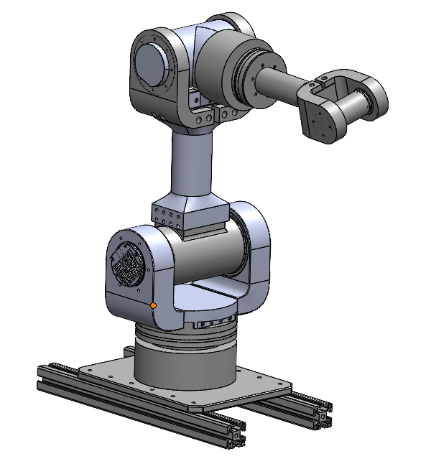
Weekly Assigned Tasks
Jade - Solidworks Refinement/Prototyping/Assembly
Izzy - Motor Research and testing
Dalton - Assembly/Motor Testing
Morgan - Purchase Orders/Electrical

Slide 4
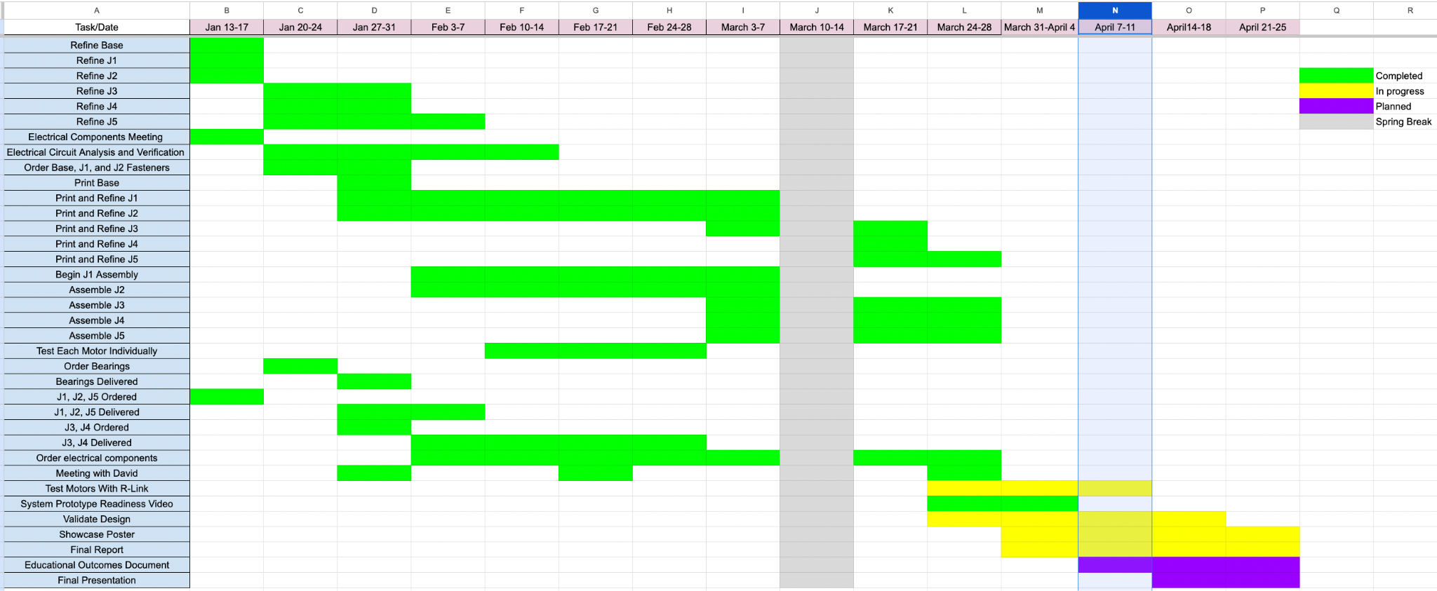
Schedule Update

Slide 5
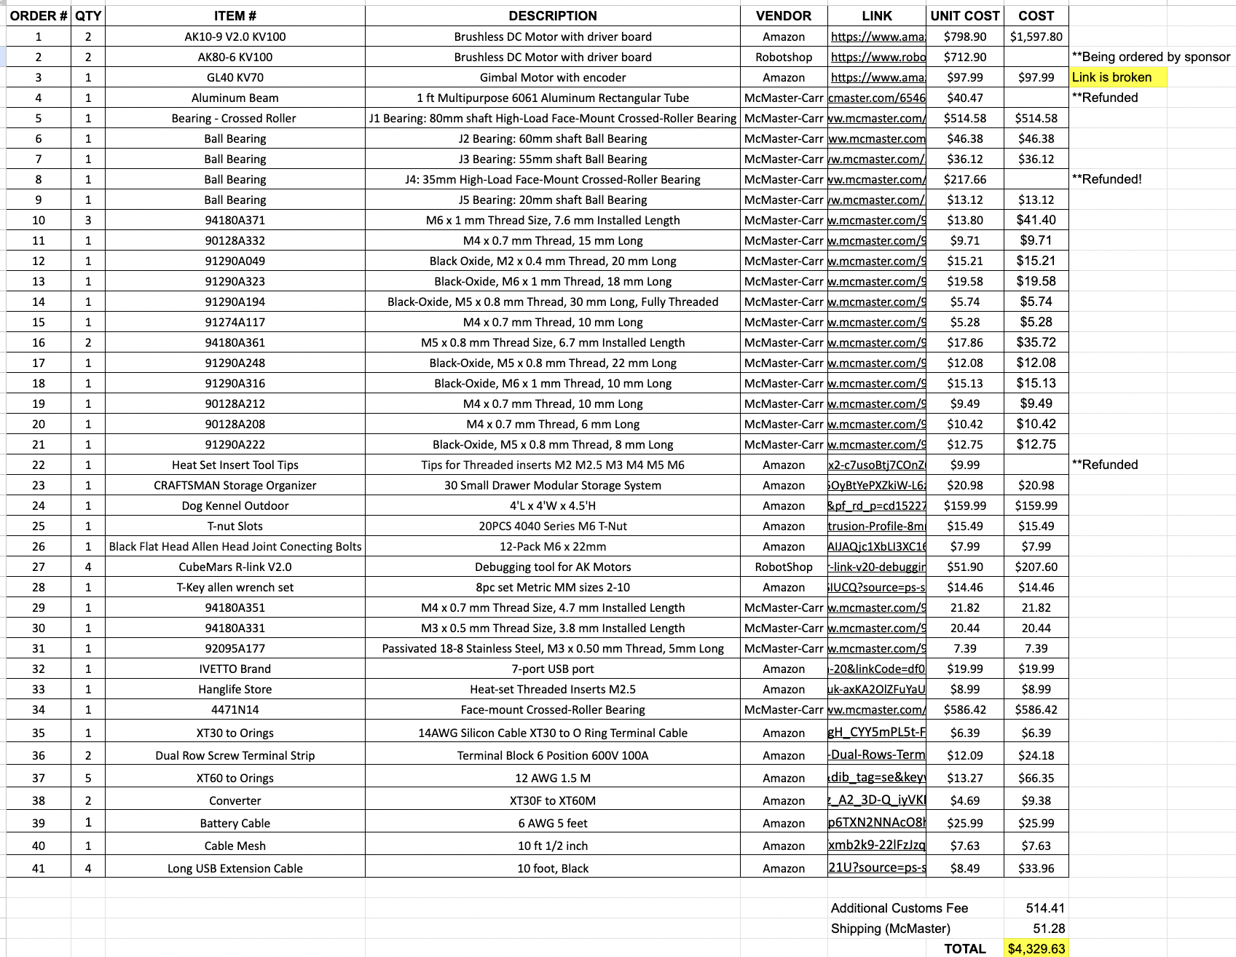
Budget Update

Slide 6
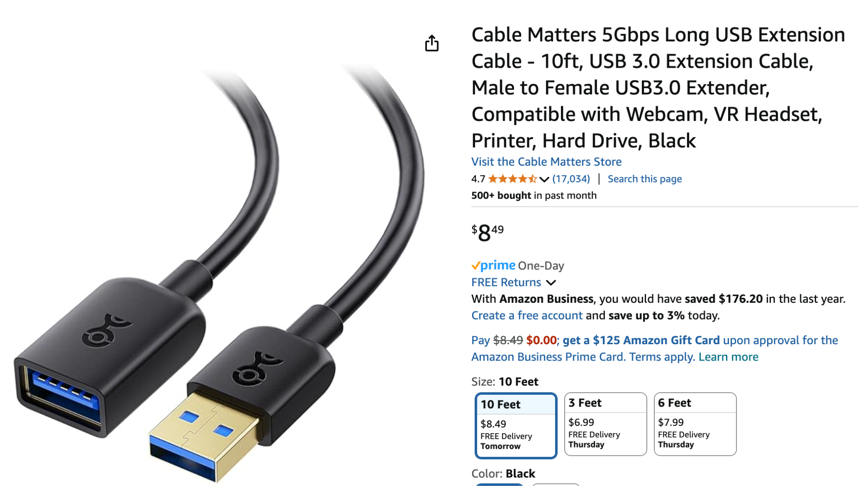
Orders Update
USB Extension Cable for R-link connection

Slide 7
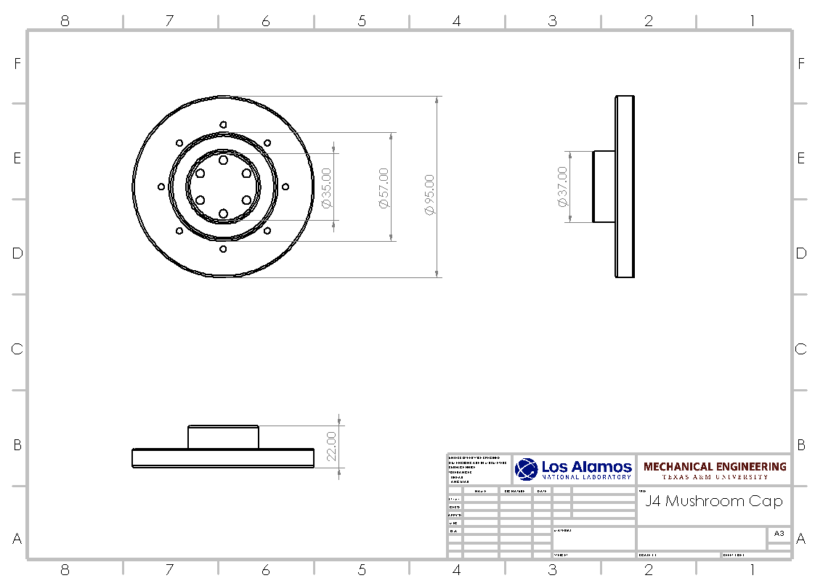
Final Report
Completed all Engineering Drawings for Prototyped parts
Will be included in appendix of final report

Slide 8
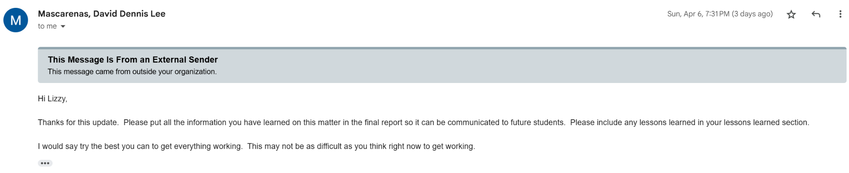
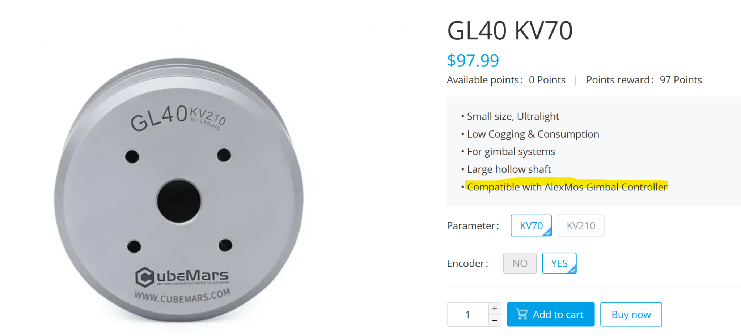
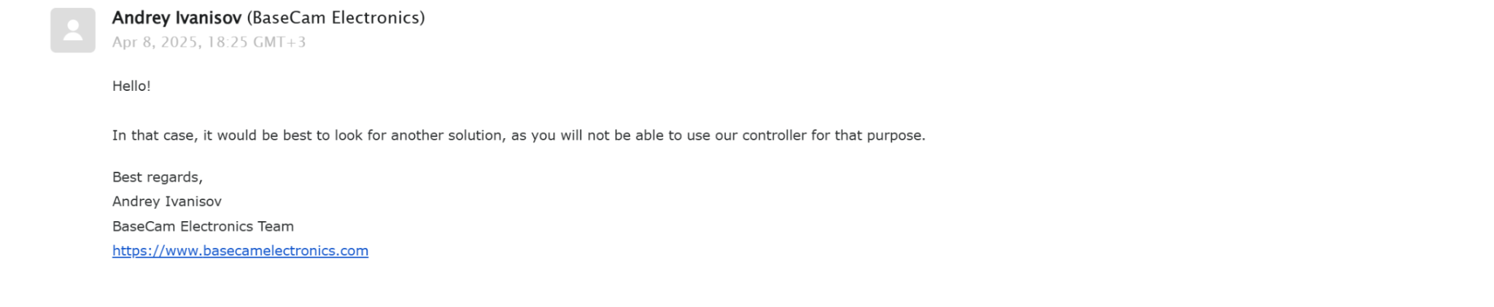
J5 Motor Testing
Investigating unexpected issues with the J5 motor
Engaging with recommended vendors to identify the appropriate motor driver
Providing daily updates to project sponsor
Actively exploring integration with Elmo Motion Control software

Slide 9
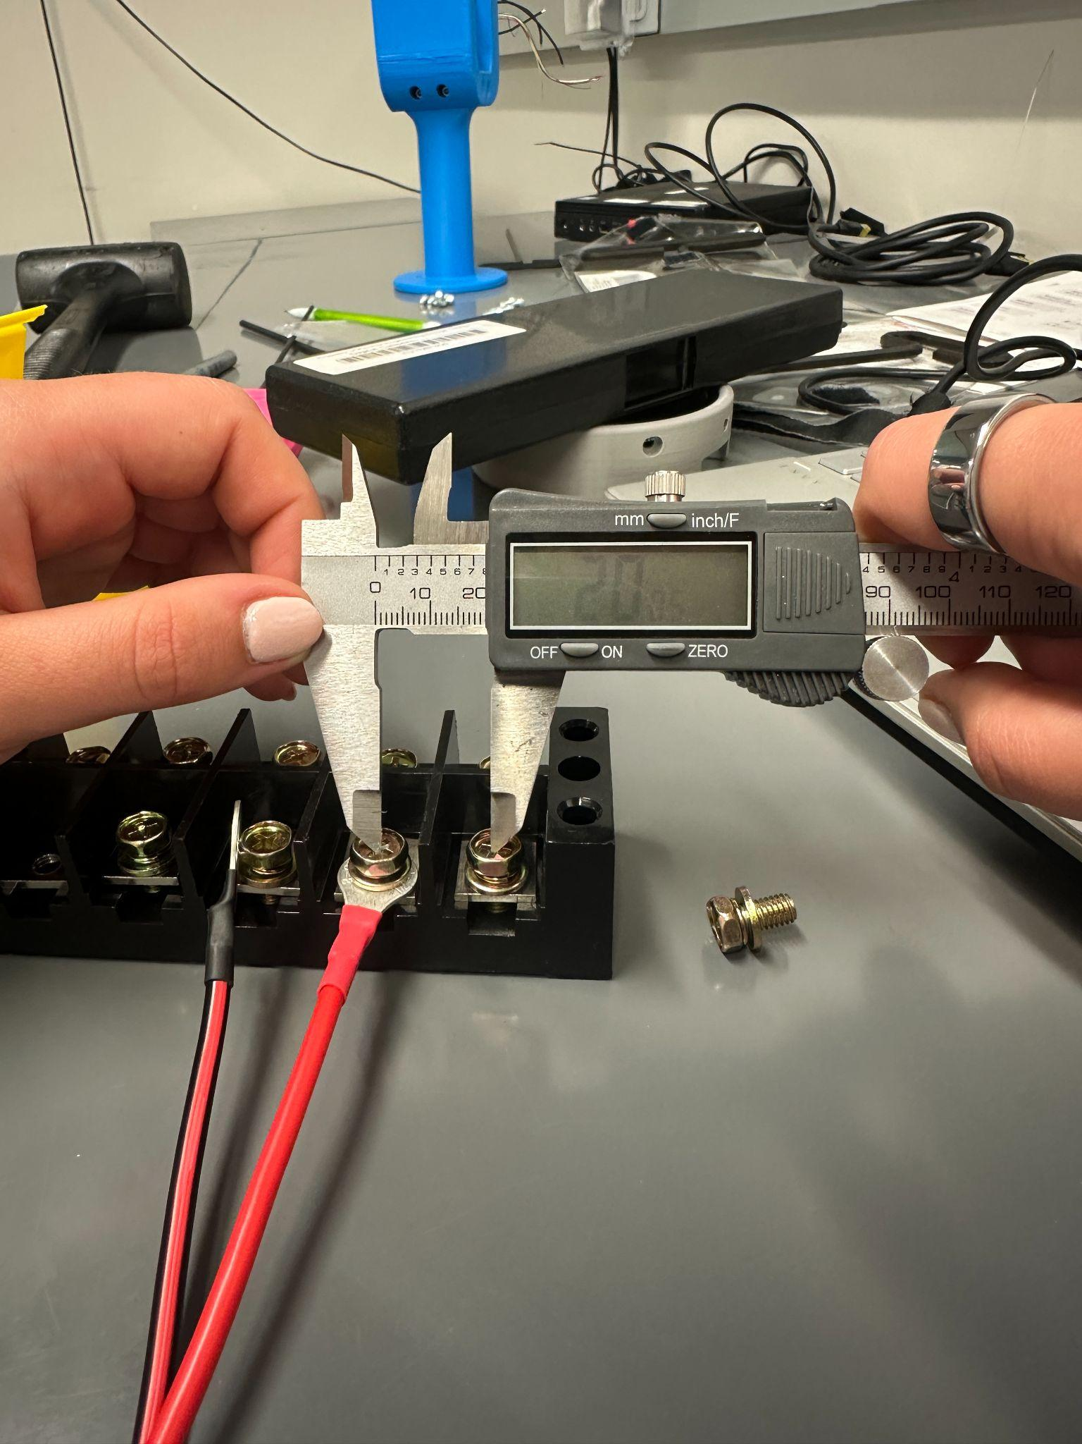
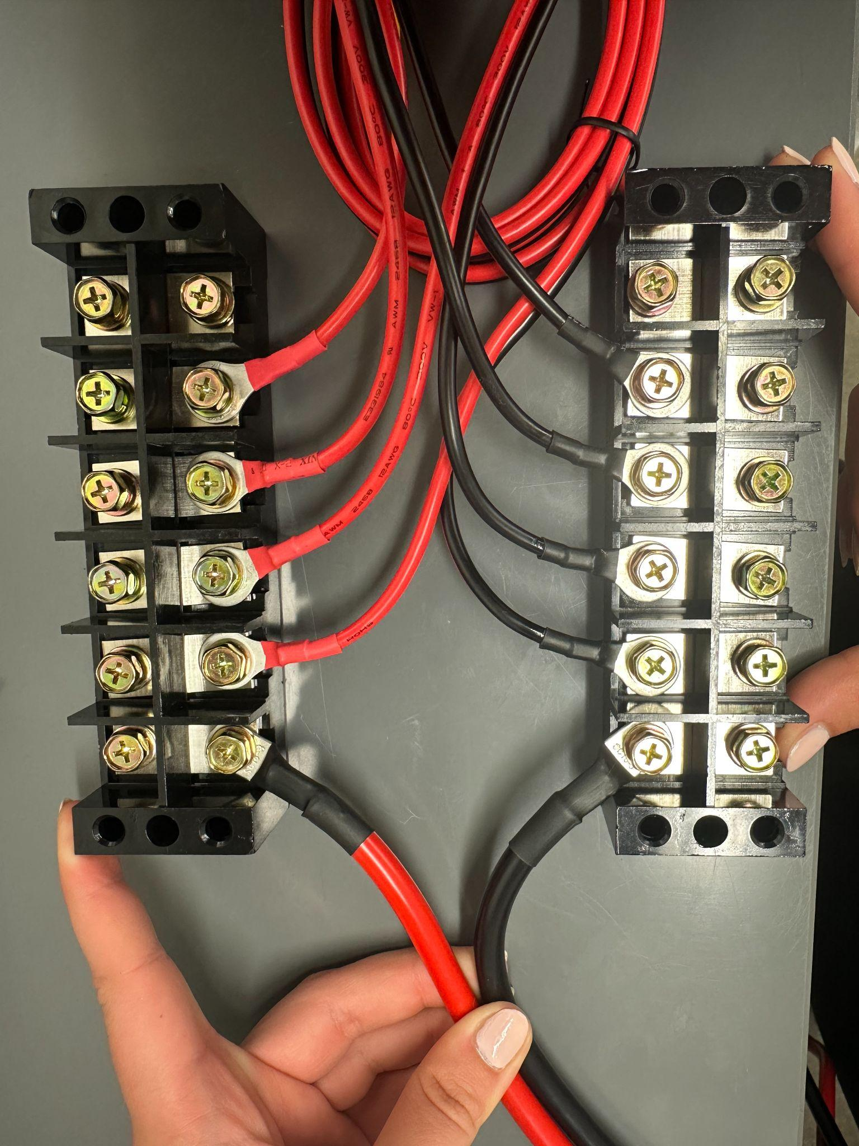
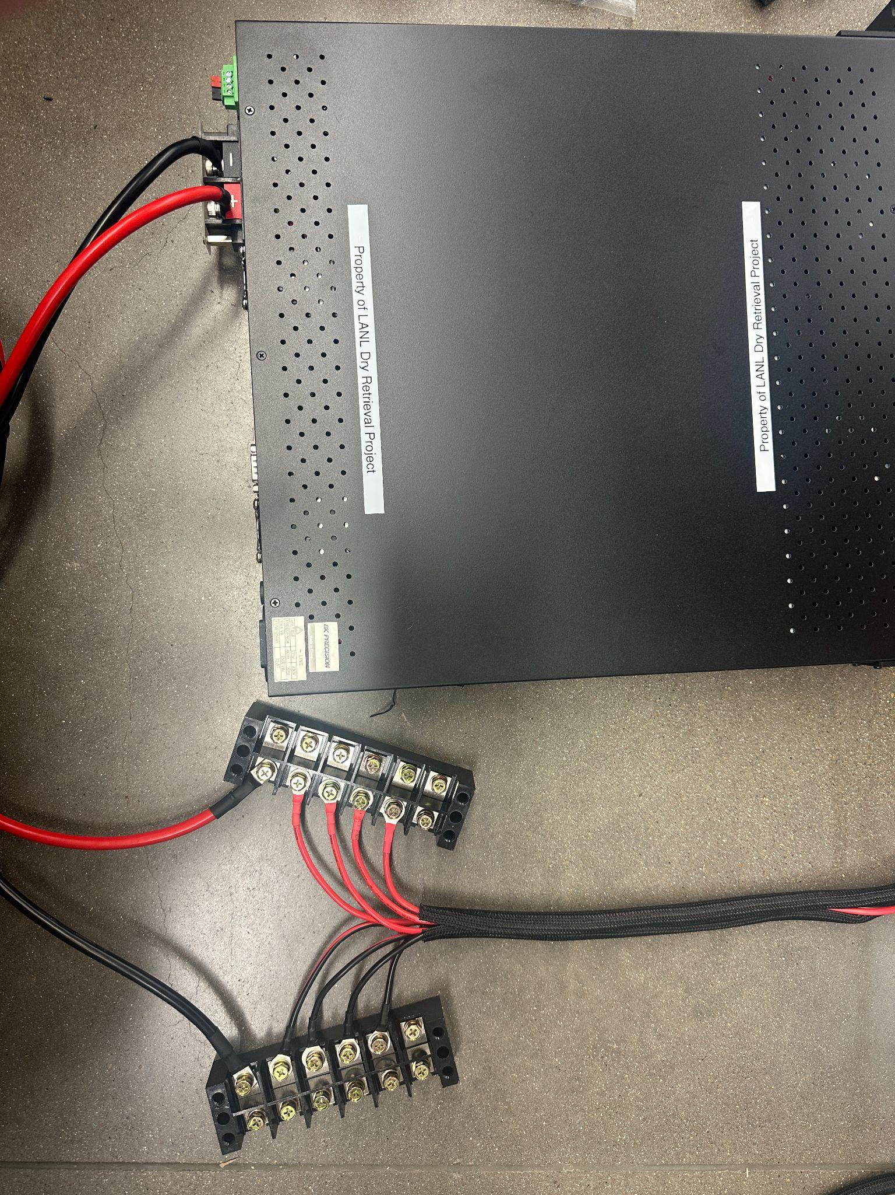
Electrical Setup

Slide 10
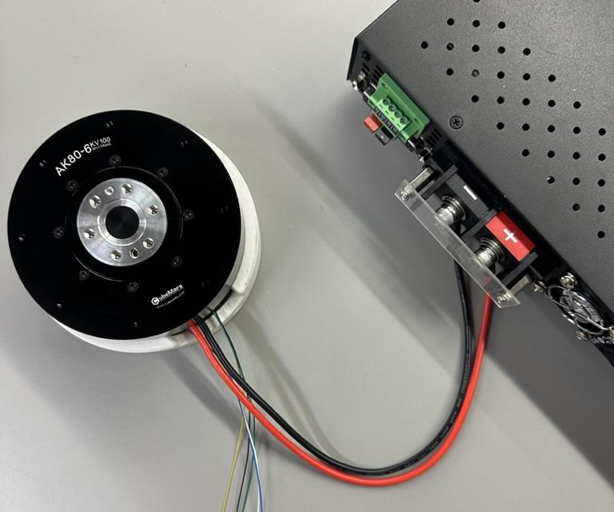
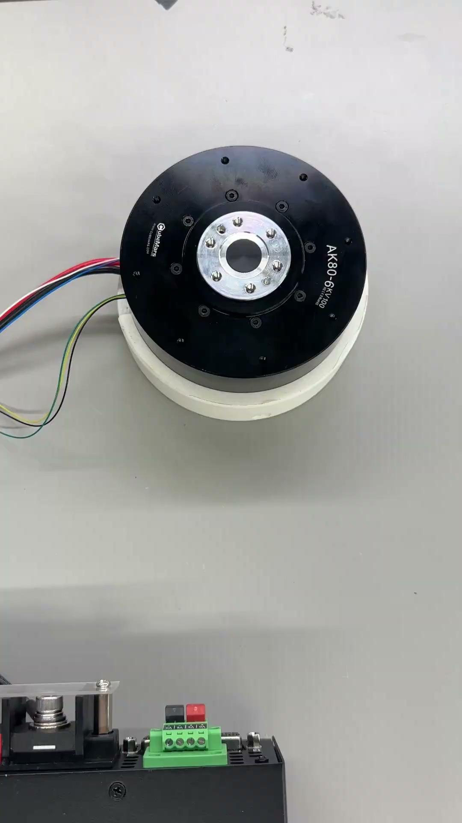
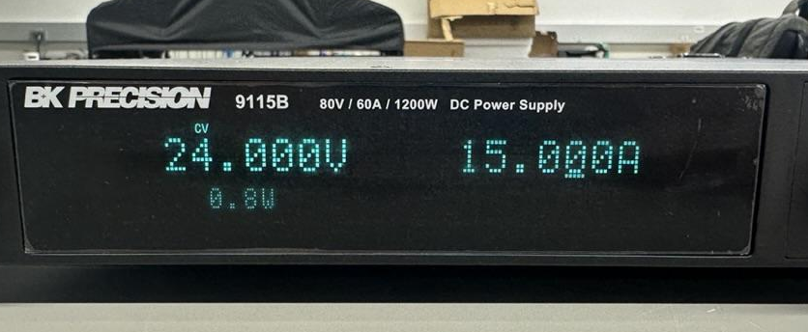
Power Supply Validation

Slide 11
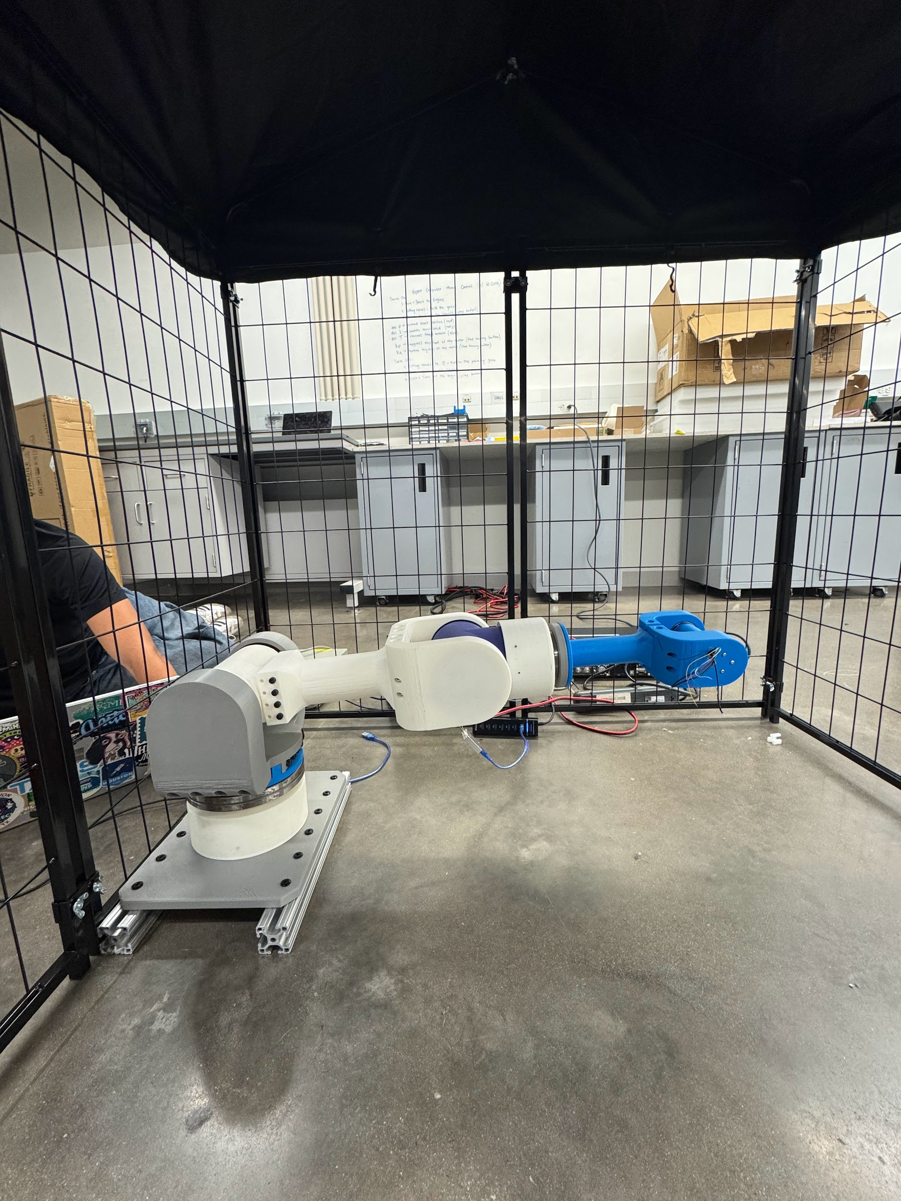
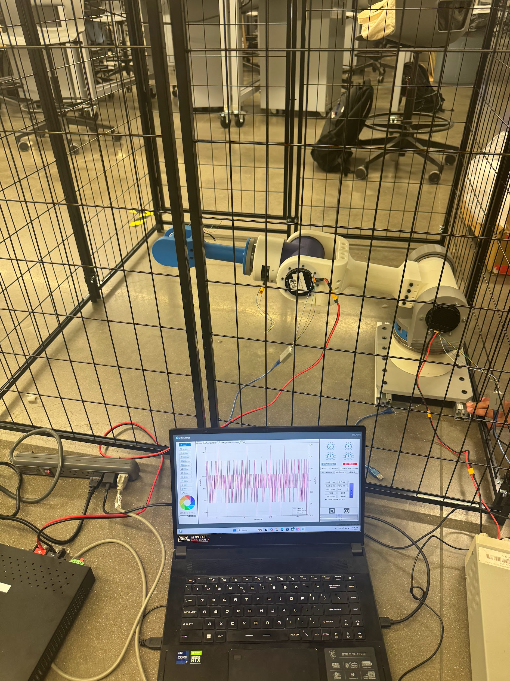
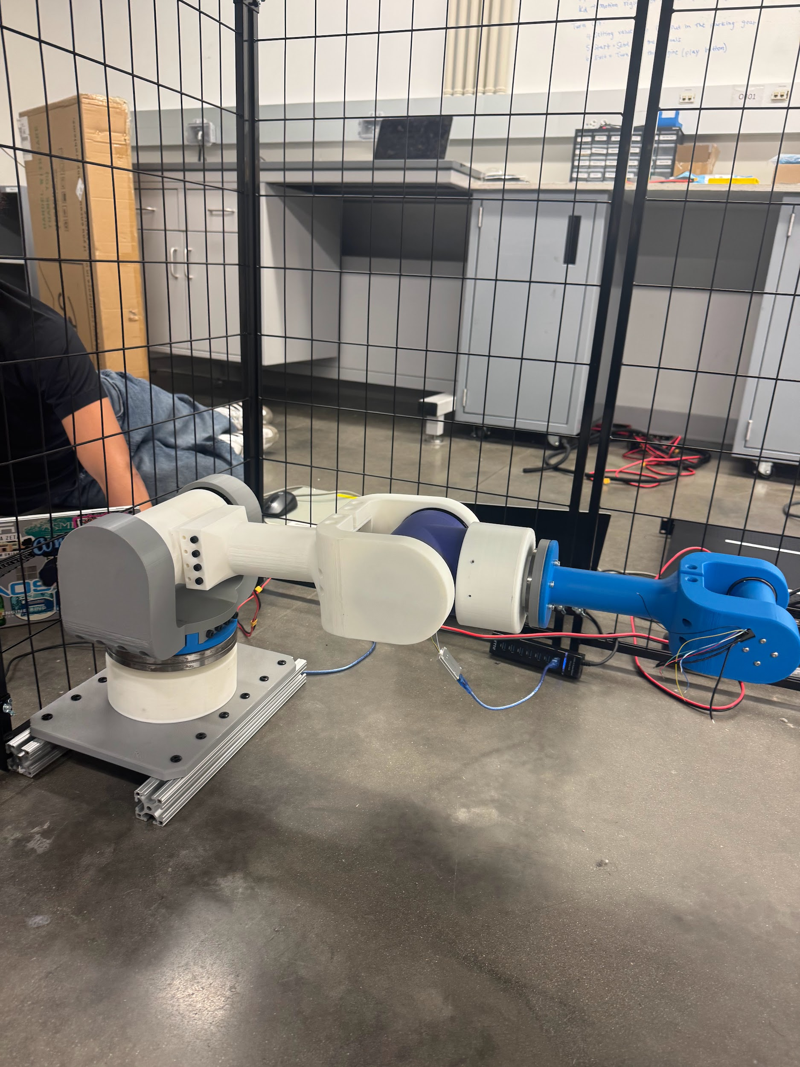
Testing
J2 Motor (with J3 off)
Torque = 12 Nm
J2 Motor (with J3 on)
Torque = 20 Nm
Amps = 0.7 A
J3 Motor
Torque = 2 Nm
Watts = 5.2 W

Slide 12
Future Work
Verify electrical components
Test motors from common hub
Continue Assembly Manual changes and updates
Film milestone video
Continue GitHub repository to streamline and document the assembly process
Work on Final Report, Final Presentation, and poster
Final Presentation April 24th 5:00 - 6:00 PM in Zachry Room 256

